Slide 1
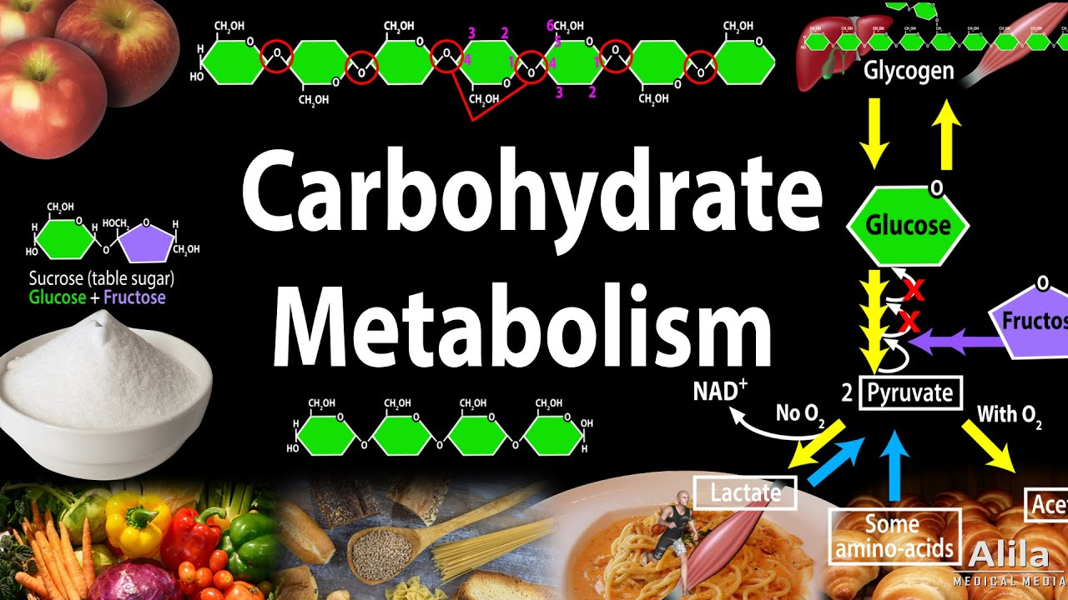
By: Dr. Kalpana Jorasia
Assistant Professor
(VPB)

Slide 2
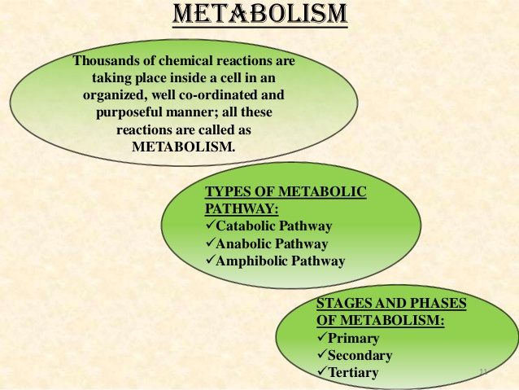

Slide 3
1. Catabolism : The degradative processes concerned with the breakdown of complex molecules to simpler ones, with a concomitant release of energy.
2.Anabolism : The biosynthetic reactions involving the formation of complex molecules from simple precursors.

Slide 4
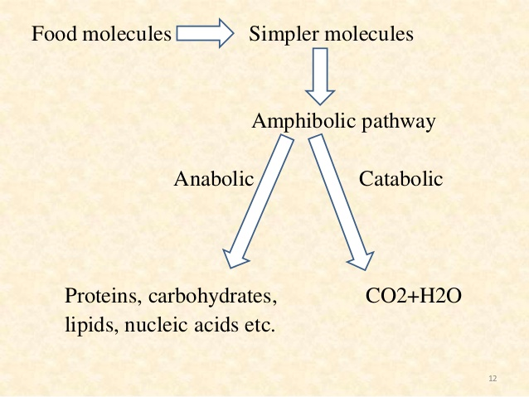
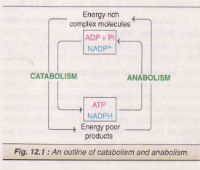

Slide 5
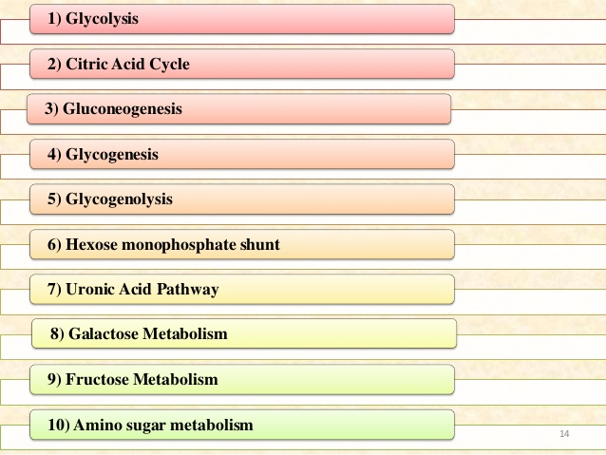

Slide 6
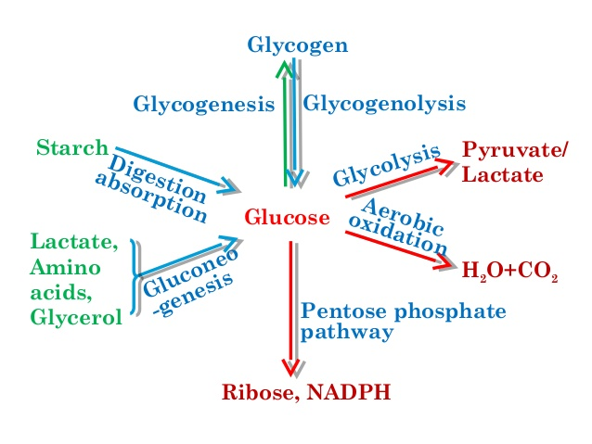

Slide 7
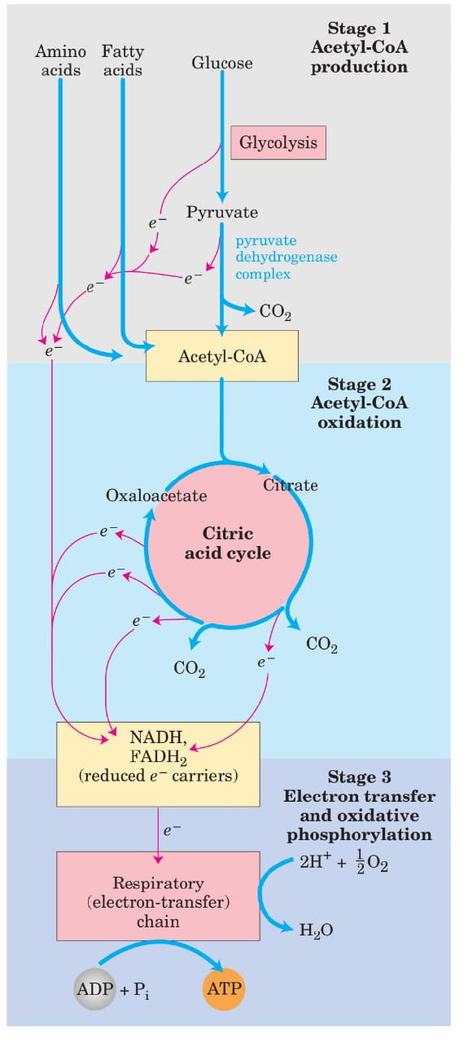
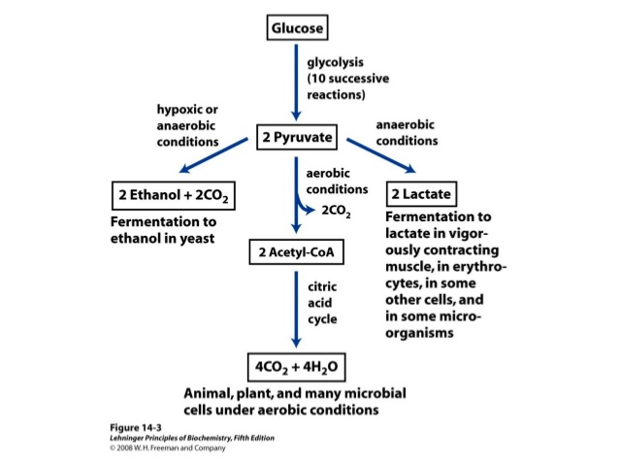

Slide 8
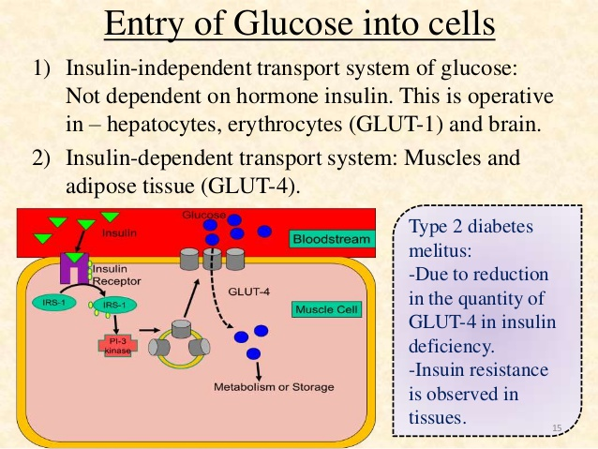

Slide 9
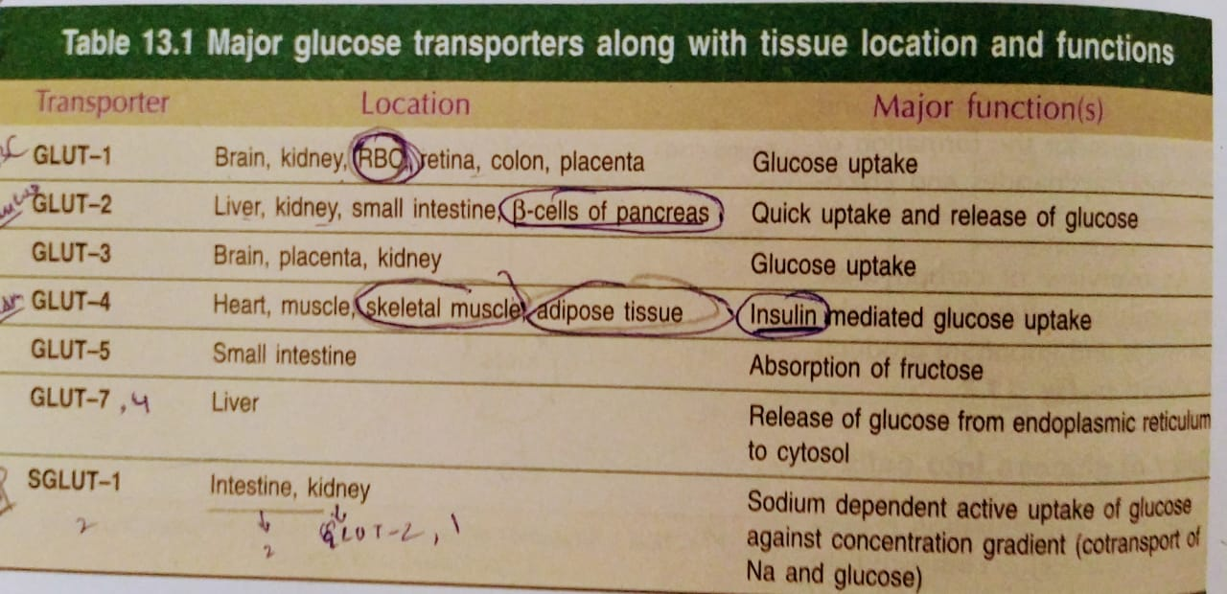

Slide 10
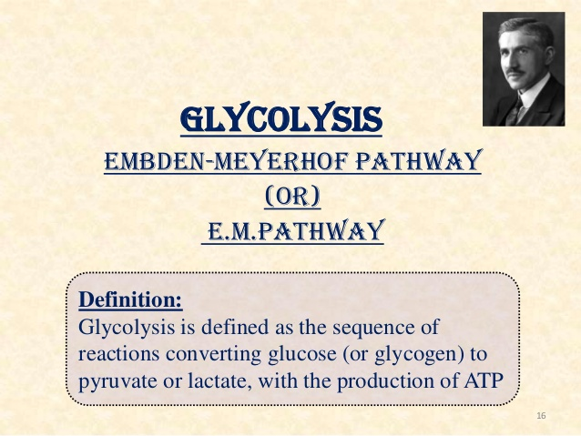
CYTOSOL

Slide 11
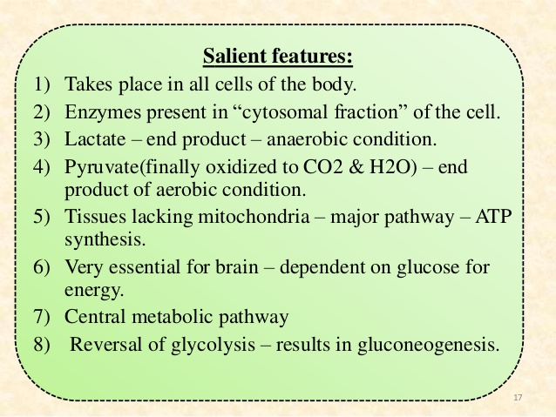

Slide 12
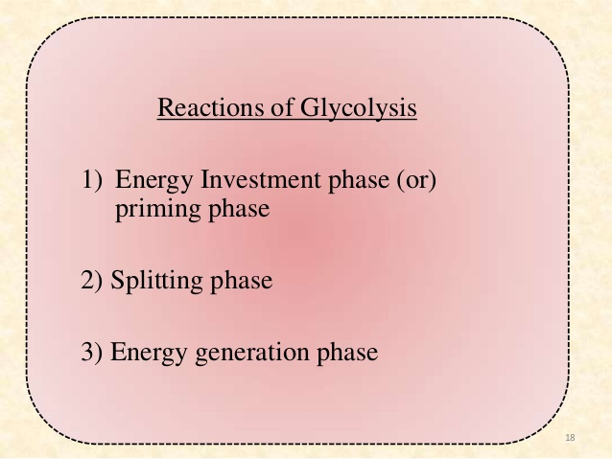

Slide 13
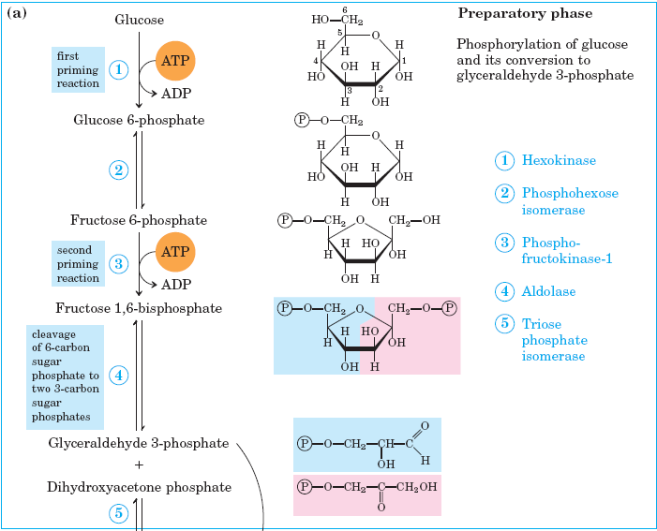

Slide 14
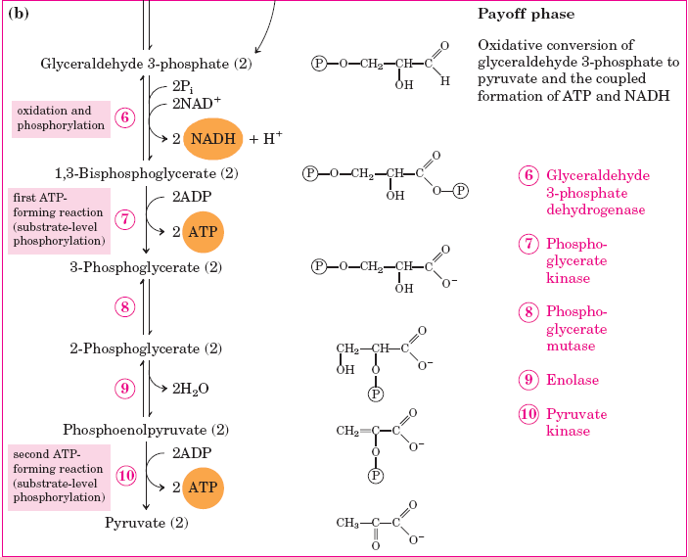

Slide 15
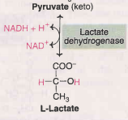
In anaerobic glycolysis
Irreversible steps in glycolysis
The three steps catalysed by the enzymes are irreversible
1. Hexokinase
2. Phosphofructokinase(PFK)- rate limiting commited step
3. Pyruvate kinase

Slide 16
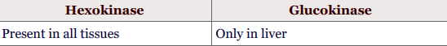
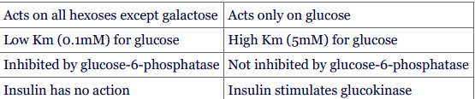

Slide 17
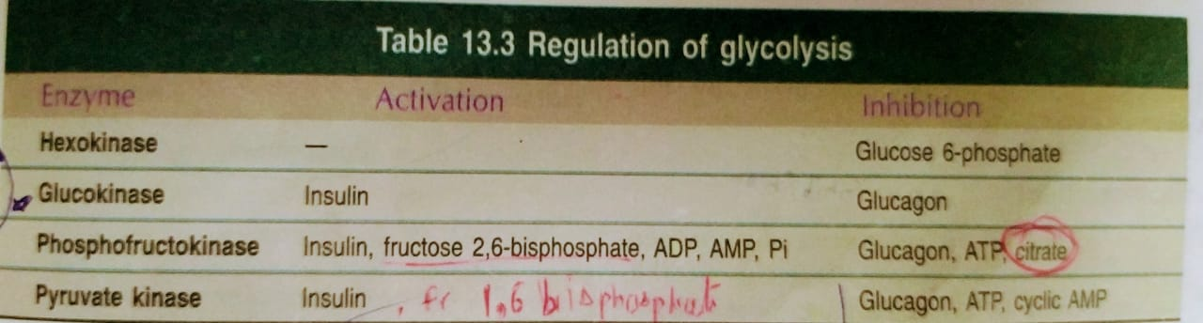
glyceraldehyde 3-phosphate is inhibited by idoacetate and arsenate
Enolase: This enzyme requires Mg²⁺ or Mn²⁺ and is inhihited by fluoride.

Slide 18
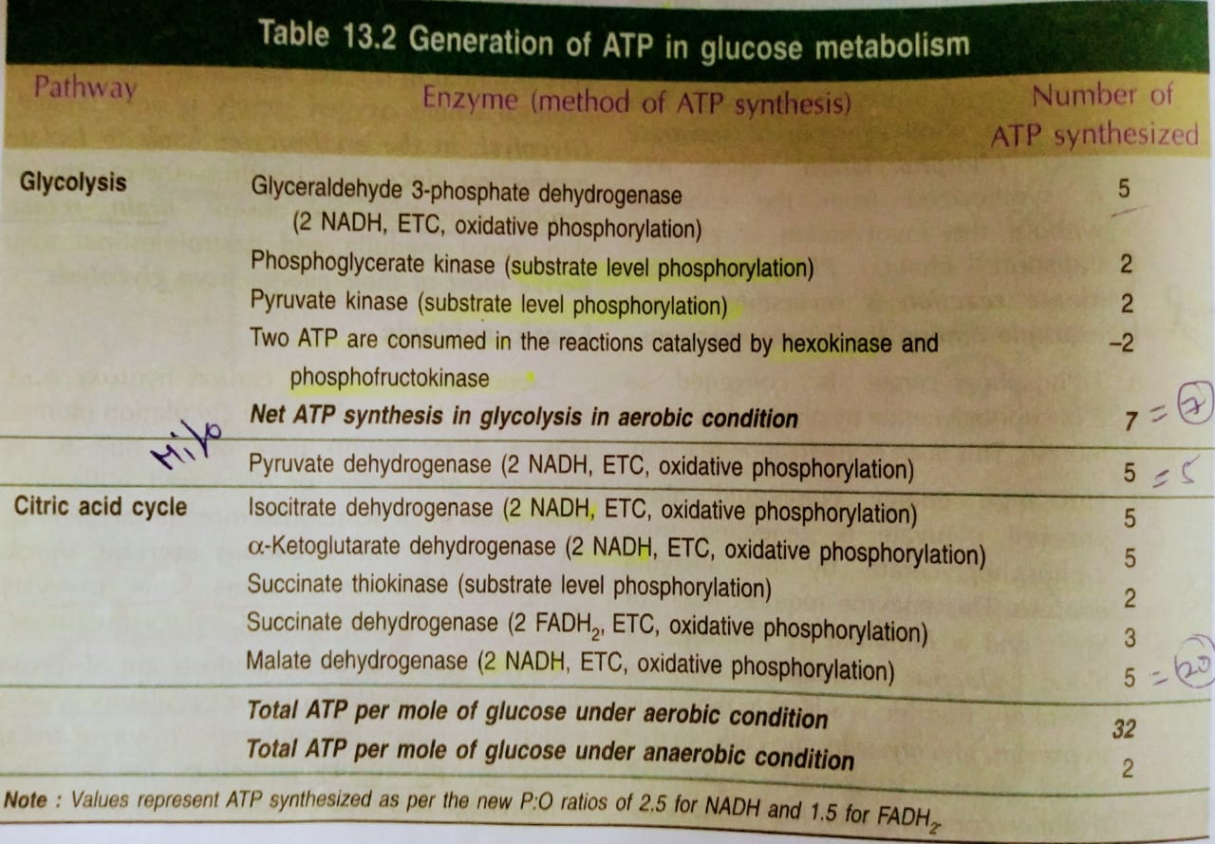
Energetics of glycolysis and citric acid cycle
3 ATP are produced from glycogen.

Slide 19
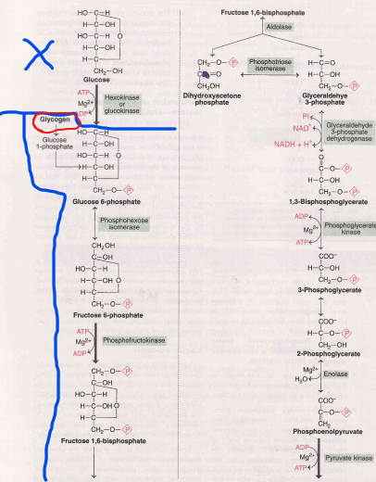

Slide 20
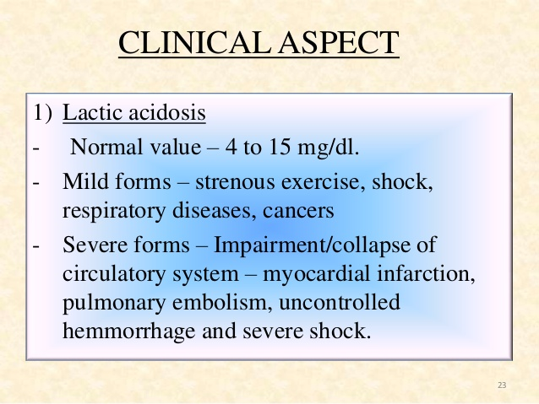

Slide 21
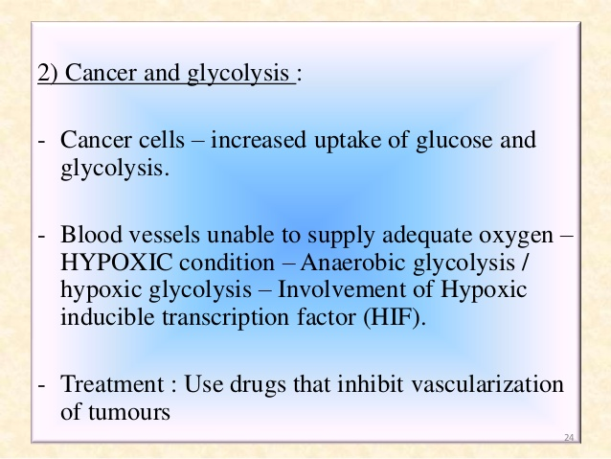

Slide 22
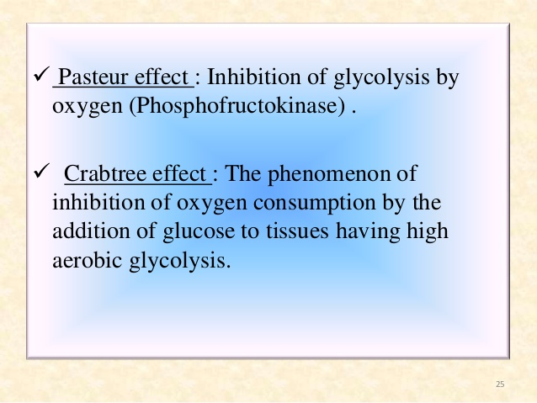

Slide 23
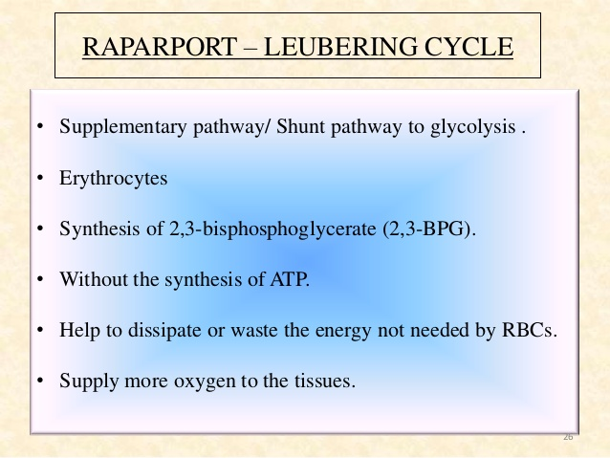
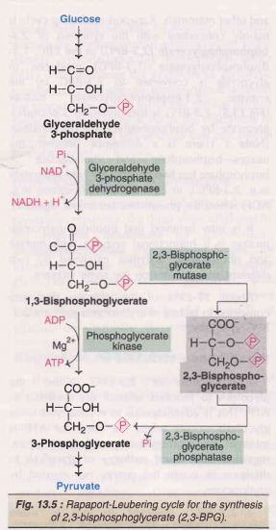

Slide 24
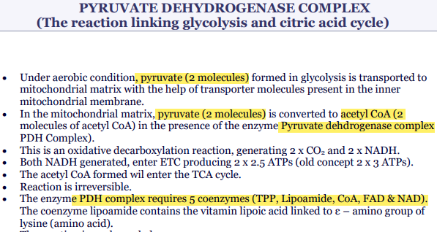

Slide 25
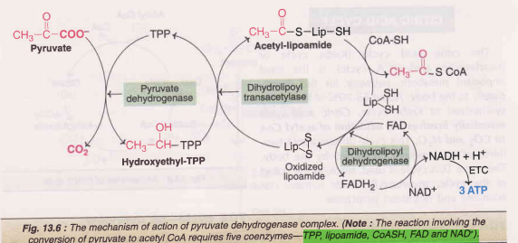
Pyruvate + NAD + CoA Acetyl CoA + CO₂ + NADH + H⁺
PDH
Regulation of PDH
Pyruvate dehydrogenase is a good example for end product (acetyl CoA, NADH) inhibition.

Slide 26
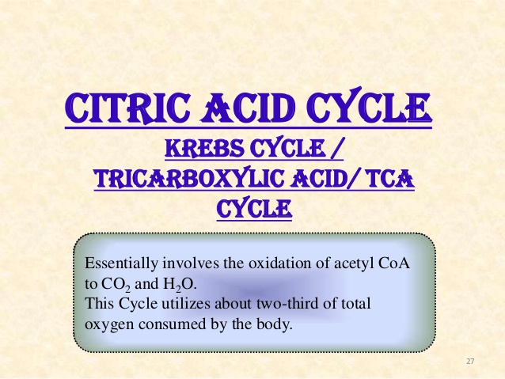
Mitochondrial Matrix

Slide 27
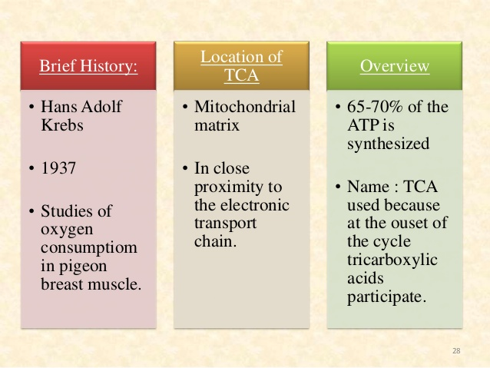

Slide 28
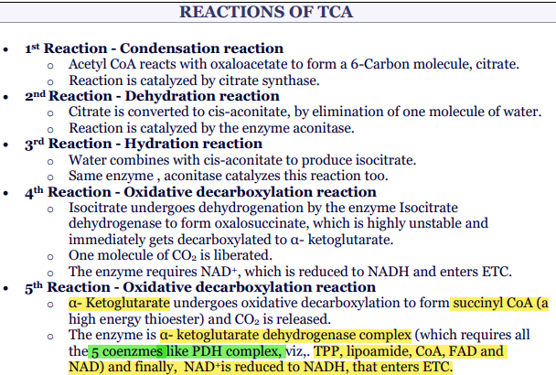

Slide 29
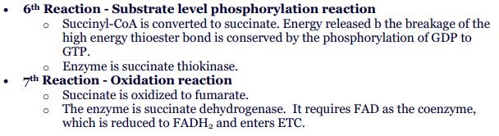
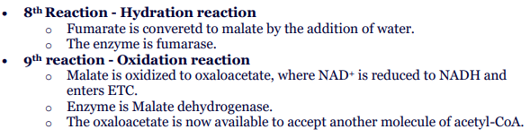

Slide 30
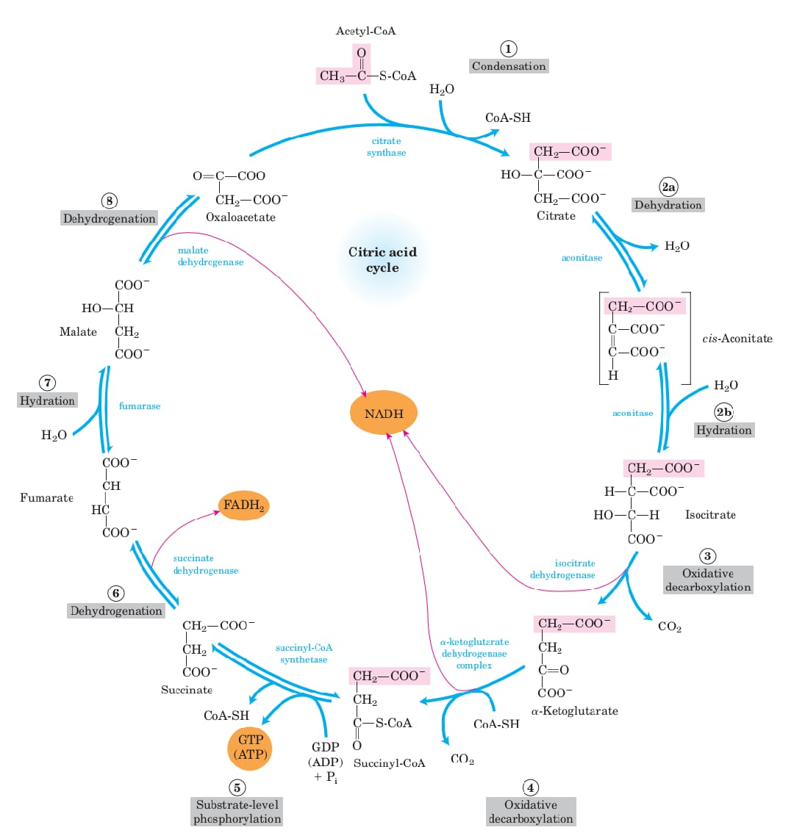

Slide 31
Regulation of citric acid cycle
1. Citrate synthase is inhibited by ATP, NADH, acetyl CoA and succinyl CoA.
2. lsocitrate dehydrogenase is activated by ADP, and inhibited by ATP and NADH.
3. -Ketoglutarate dehydrogenase is inhibited by succinyl CoA and NADH.
4. Availability of ADP
5. Hyperammonemia

Slide 32
Vitamins for TCA cycle and PDH (pyruvate dehydrogenase).
1. Thiamine (vit. B₁) as TPP
2. Riboflavin (vit.B₂) as FAD
3. Niacin (vit B₃) as NAD⁺
4. Pantothenic acid (vit. B₅) as coenzyme A
5. Vitamine like compound namely lipoic acid.

Slide 33
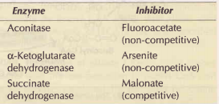
Inhibitors of citric acid cycle/ TCA

Slide 34
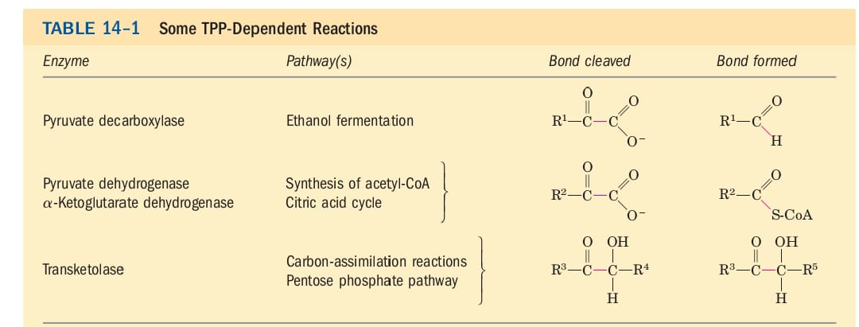
(TPP)Thiamine Pyrophosphate (vitamine B₁)

Slide 35
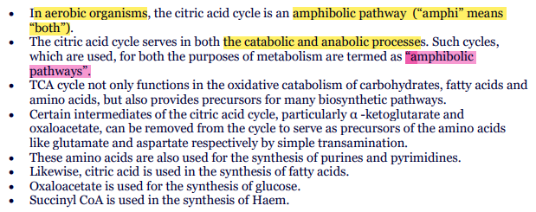
Amphibolic pathways

Slide 36
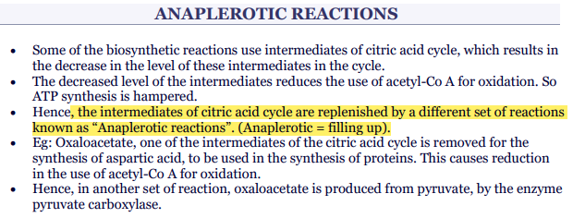

Slide 37
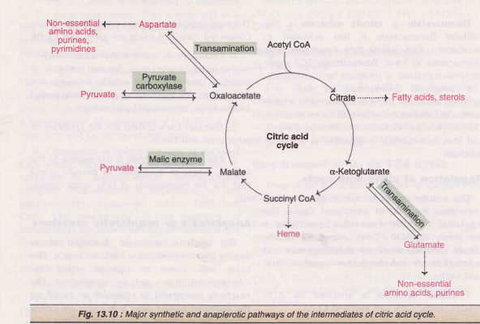

Slide 38
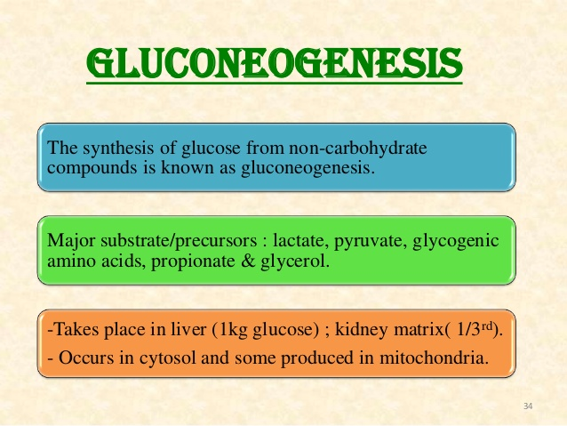

Slide 39
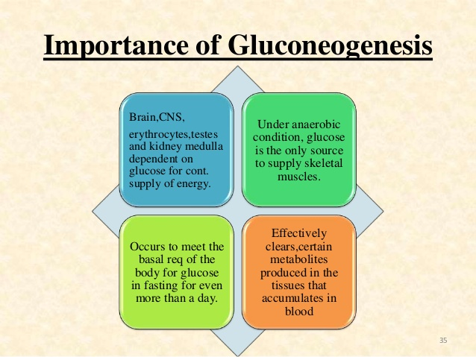

Slide 40
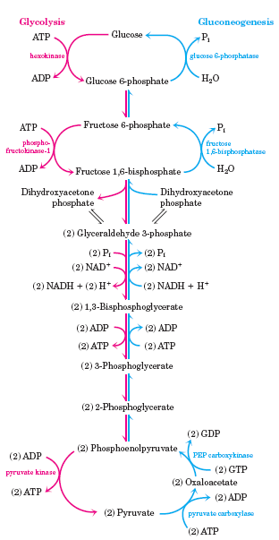
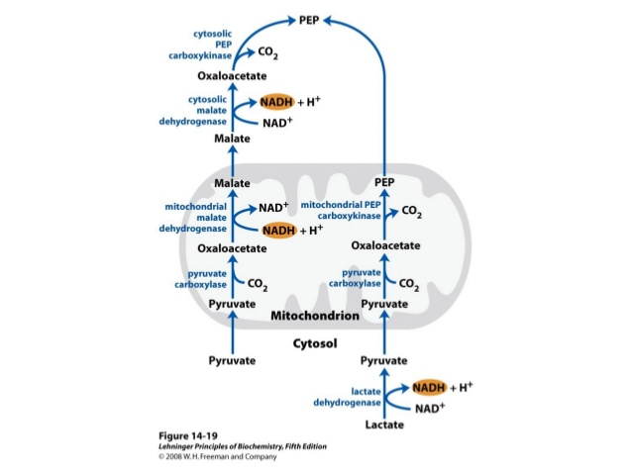

Slide 41
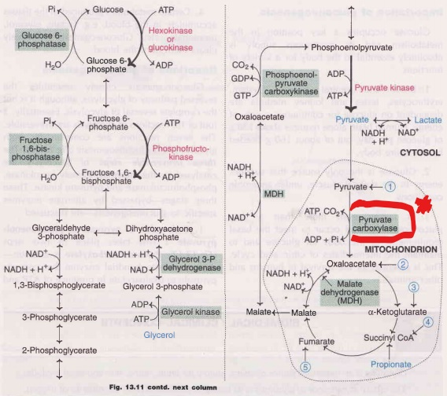
Pyruvate carboxylase is a biotin (vitamineB₇) dependent mitochondrial enz.

Slide 42
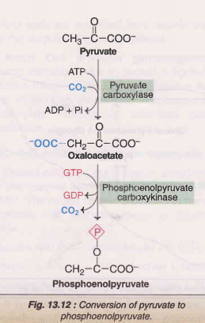
Gluconeogenesis (some important points)
Gluconeogenesis occurs in cytosol and some produced in mitochondria.
Pyruvate carboxylase is a biotin (vitamineB₇) dependent mitochondrial enzyme.
Glucose 6-phosphatase absent in muscles, brain and adipose tissue so there no gluconeonesis in these tissues.
Leucine and lysine (amino acids)- not involved in gluconeogenesis
Lactate is a dead end in glycolysis.

Slide 43
ENERGETICS of Gluconeogenesis
Energy used in this pathway
Pyruvate carboxylase - 1 ATP
Phosphoenolpyruvate carboxykinase - 1 GTP (equivalent to 1 ATP)
Phosphoglycerate kinase - 1 ATP
Two pyruvate molecules are required to synthesize one molecule of glucose. Hence, 6 ATPs are needed to form glucose.
In addition, two moles of NADH are also required per mole of glucose synthesized.

Slide 44
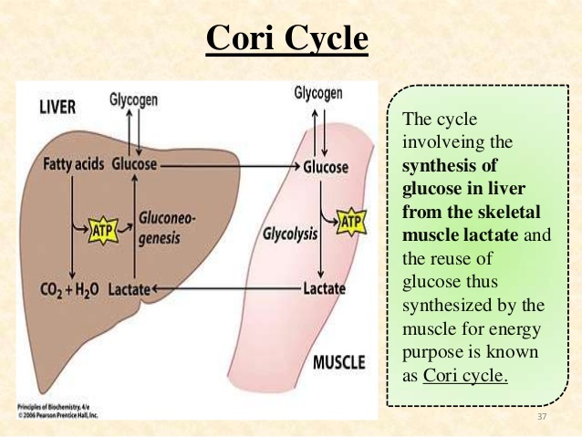
Gluconeogenesis from lactate (Cori cycle)
The cycle involving the synthesis of glucose in liver from the skeletal muscle lactate and the reuse of glucose thus synthesized by the muscle for energy purpose is known as Cori cycle.

Slide 45
Glucose-alanine cycle
There is a continuous transport of amino acids from muscle to liver, which predominantly occurs during starvation. Alanine dominates among the transported amino acids. It is postulated that pyruvate in skeletal muscle undergoes transamination to produce alanine. Alanine is transported to liver and used for gluconeogenesis. This cycle is referred to as glucose-alanine cycle.

Slide 46
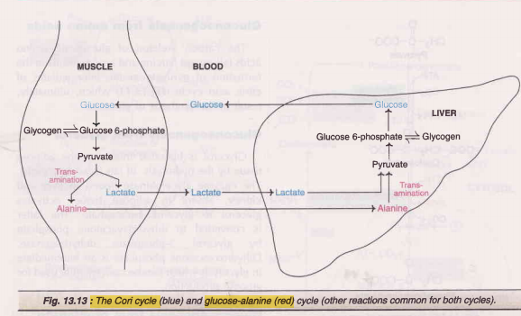
Glucose-alanine cycle

Slide 47
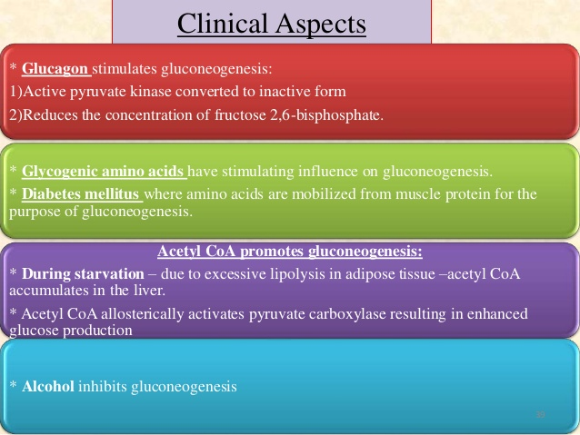
Regulation of gluconeogenesis

Slide 48
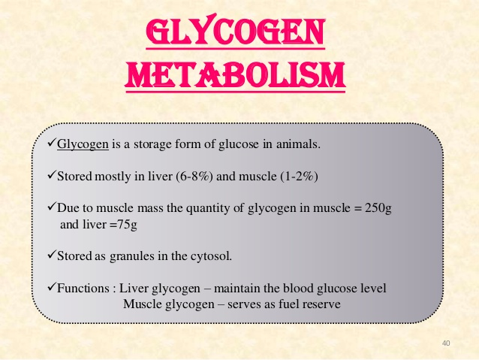
CYTOSOL

Slide 49
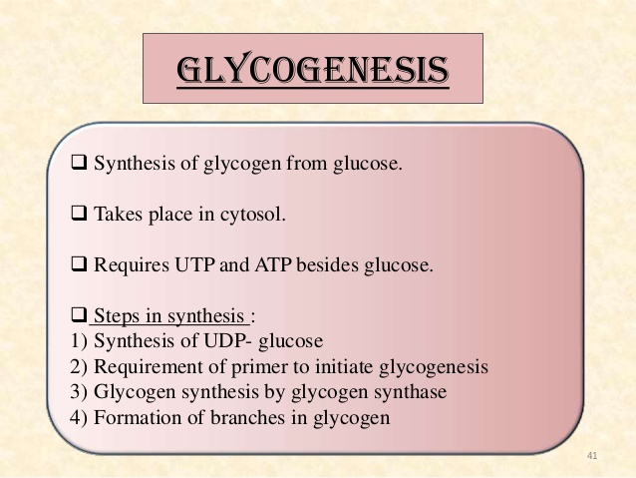
(Glycogen synthase)
(Glycogenin primer)
(Glucosyl alpha-4-6 transferase)

Slide 50


Of the two ATP utilized, one is required for the phosphorylation of glucose while the other is needed for conversion of UDP to UTP

Slide 51

CYTOSOL
Glycogen phosphorylase

Slide 52



Slide 53
Regulations of glycogenesis and glycogenolysis
A good coordination and regulation of glycogen synthesis and its degradation are essential to maintain the blood glucose levels. Glycogenesis and glycogenolysis are,respectively, controlled by the enzymes glycogen synthase and glycogen phosphorylase.
Regulation of these enzymes is accomplished by three mechanisms
1 . Allosteric regulation
2. Hormonal regulation
3. Influence of calcium.

Slide 54

Allosteric regulation of glycogenolysis & glycogenesis

Slide 55

Glycogenesis

Slide 56

Glycogenolysis

Slide 57

(Lysosomal alpha-1,4 glucosidase)
(Amylo alpha 1,6-glucosidase)
(amylopectinosis)
(Glucosyl 4-6 transferase)

Slide 58


Slide 59

CYTOSOL
“Warburg-Dickens pathway”

Slide 60


Slide 61
The reactions in HMP pathway, are divided into 2 phases
1. Oxidative Phase
Glucose 6-phosphate dehydrogenase (G6PD) regulates HMP shunt
2. Non-oxidative Phase.
The enzyme transketolase catalyses the transfer of two carbon moiety from xylulose 5-phosphate to ribose 5-phosphate to give a 3-carbon glyceraldehyde 3-phosphate and a 7-carbon sedoheptulose 7-phosphate. Transketolase is dependent on the coenzyme thiamine pyrophosphate (TPP) and Mg2+ ions

Slide 62


Slide 63



Slide 64


Slide 65


Slide 66



Slide 67


Slide 68


Slide 69


Slide 70


Slide 71



Slide 72


Slide 73

Metabolism of Galactose

Slide 74


Slide 75


Slide 76


Slide 77
GLYOXYLATE CYCLE
Glyoxylate pathway was elucidated by Hans Kornberg and Neil Madsen.
The animals, including man, cannot carry out the net synthesis of carbohydrate from fat.
However, the plants and many microorganisms are equipped with the metabolic machinery-namely the glyoxylate cycle-to convert fat into carbohydrates. This pathway is very significant in the germinating seeds where the stored triacylglycerol (fat) is converted to sugars to meet the energy needs.
Location of the cycle : The glyoxylate cycle occurs in glyoxysomes, specialized cellular organelles, where fatty acid oxidation is also operative.

Slide 78

REACTIONS OF THE CYCLE
Each turn of the cycle consumes 2 molecules of acetyl CoA.
Glyoxysomes contain isozymes of TCA cycle enzymes, viz., citrate synthase, aconitase and malate dehydrogenase.
Reactions are occuring in three compartments - glyoxysomes, mitochondria and cytosol; the following 4 pathways participate in the conversion of lipid to carbohydrates.
1. β-oxidation - to convert fatty acid into acetyl CoA - takes place in glyoxysomes.
2. Glyoxylate cycle - to convert isocitrate into succinate - takes place in glyoxysomes.
3. TCA cycle - to convert succinate into malate - takes place in mitochondria.
4. Gluconeogenesis - to convert malate into phosphoenol pyruvate (PEP) and then to glucose - takes place in cytosol.

Slide 79


Slide 80


Slide 81


Slide 82


